Slide 1
DEEP LEARNING ARCHITECTURES AND TRAINING

Slide 2
Agenda
Recurrent Neural Networks (RNNs)
Recurrent Neurons
Vanishing Gradient Problem
LSTM & GRU
Building & Training RNN
Overfitting & Regularization techniques
Dropout & Normalization
Model Evaluation, Metrics & Hyperparameter Techniques
Practical Exercise: RNN, LSTM, GRU

Slide 3
Recurrent Neural Networks (RNNs)
RNN is a neural network designed for sequential data, featuring recurrent connections that maintain memory.
Importance of Sequential Data: RNNs are essential for tasks like time series analysis, natural language processing, and speech recognition where data order matters.
Traditional Feedforward Networks: Standard neural networks (MLPs) lack memory and struggle with sequences due to fixed input-output sizes.
Need for Recurrent Connections: RNNs use loops to pass information from one step to the next, crucial for maintaining context and dependencies in sequential data.
Role of Memory in RNN: RNNs employ internal memory (hidden state) to remember past inputs, enabling them to process sequences effectively.

Slide 4
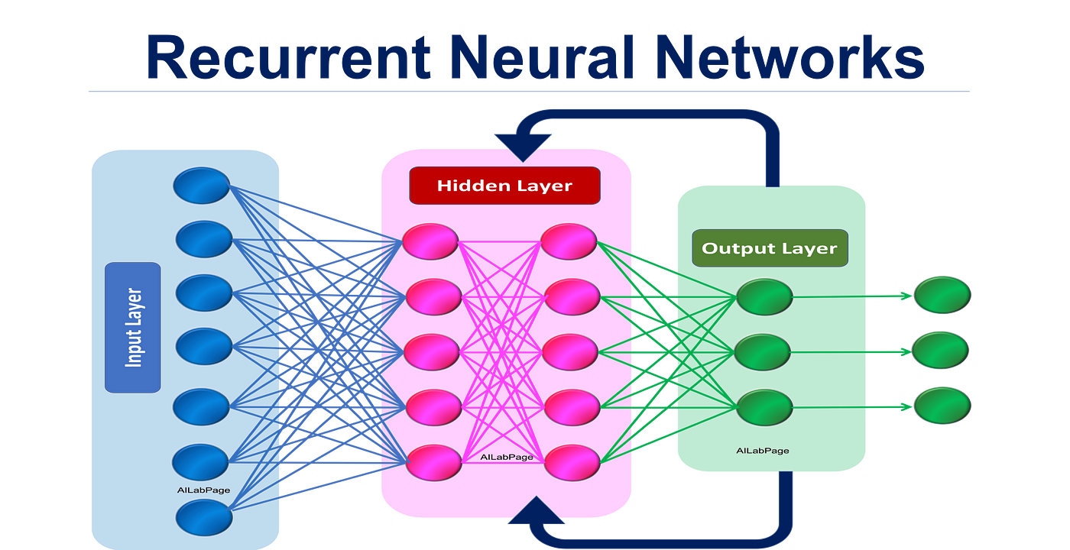
Cont…
Architecture and Components:
Recurrent Layers: Maintain hidden states for sequential context.
Input Sequences: Process data sequentially.
Output Sequences: Can generate sequences as output.

Slide 5
Cont…
Use Cases in Sequential Data Analysis:
NLP (Text analysis)
Time Series Forecasting
Speech Recognition
Handwriting Recognition
Video Analysis
Music Generation
Autonomous Systems
RNNs are crucial for tasks involving temporal relationships and dependencies in data.

Slide 6
Recurrent Neurons
Architecture: Recurrent neurons are part of RNNs with cyclic connections to maintain hidden states over time.
Hidden State: Represents memory and context, updated using an activation function applied to input and previous hidden state.
Forward Pass: In the forward pass, they process input, update the hidden state, and produce an output.
Backward Pass: During training, gradients are computed for weight updates.
Vanishing and Exploding Gradients: RNNs can face vanishing (small gradients) and exploding (large gradients) gradient issues, impacting long-term dependencies.

Slide 7
Vanishing Gradient Problem
Gradients become very small during backpropagation in deep networks, especially in RNNs.
Implications: It hampers RNNs' ability to capture long-term dependencies, limiting their performance.
Solutions: LSTM and GRU
LSTM (Long Short-Term Memory): Uses specialized gates to mitigate vanishing gradients and handle long sequences effectively.
GRU (Gated Recurrent Unit): A more compact architecture with reset and update gates, addressing the vanishing gradient problem in a simpler way.

Slide 8
LSTM (Long Short-Term Memory)
LSTM is an RNN architecture for handling long sequences and mitigating vanishing gradient problems.
Long-Term and Short-Term Memory Cells: LSTMs have long-term (c) and short-term (h) memory cells for retaining and managing information.
Gate Mechanisms: LSTMs use three gate mechanisms:
Forget Gate: Decides what to forget from long-term memory.
Input Gate: Determines what to store in long-term memory.
Output Gate: Regulates information for short-term memory and output.

Slide 9
Cont…
Update and Reset Gates:
Update Gate: Controls how much current short-term memory is added to long-term memory.
Reset Gate: Decides how much of the previous long-term memory to forget.
Equations and Pictorial Representation: LSTMs are defined by equations describing information flow, and diagrams illustrate gate and memory cell interactions.

Slide 10
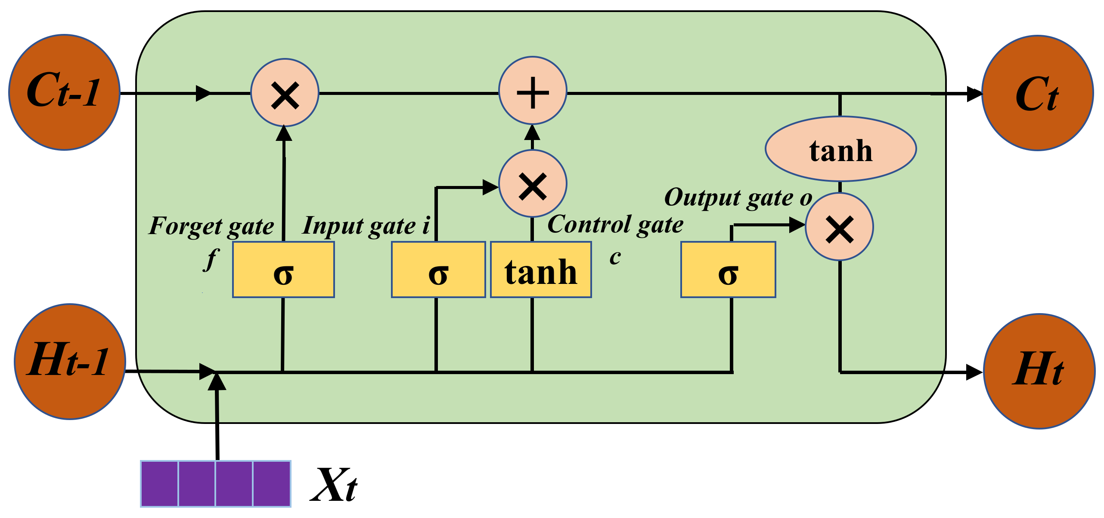
Cont…

Slide 11
Cont…
Role of Activation Functions:
Activation functions (e.g., sigmoid and tanh) are used in gates to control the amount of information passed.
They introduce non-linearity, enabling the network to capture complex patterns.
Comparison with Traditional RNNs:
LSTMs mitigate vanishing gradients and capture long-range dependencies.
Traditional RNNs lack these capabilities.
Use Cases for LSTMs:
Natural Language Processing, Speech Recognition, Time Series Analysis, Video Analysis, among others.

Slide 12
GRU(Gated Recurrent Unit)
GRUs are a variation of RNNs & known for handling sequential data effectively.
A GRU unit is similar in structure to a long short-term memory (LSTM) cell, another type of RNN cell.
GRUs consist of several gates and an internal state that helps the network maintain and update information over time.
Gates:
Update Gate (z): Manages what to keep from the previous state.
Reset Gate (r): Handles what to forget from the current state.
New Memory Content: Contains information to be incorporated into the memory.

Slide 13
Cont…
Operation:
At each time step, the GRU unit calculates these gates and updates its internal state and memory.
The update gate (z) determines how much of the previous state to keep and how much of the new candidate state to add.
The reset gate (r) decides which parts of the current state to forget.
The new memory content is then combined with the previous state to form the updated state.

Slide 14
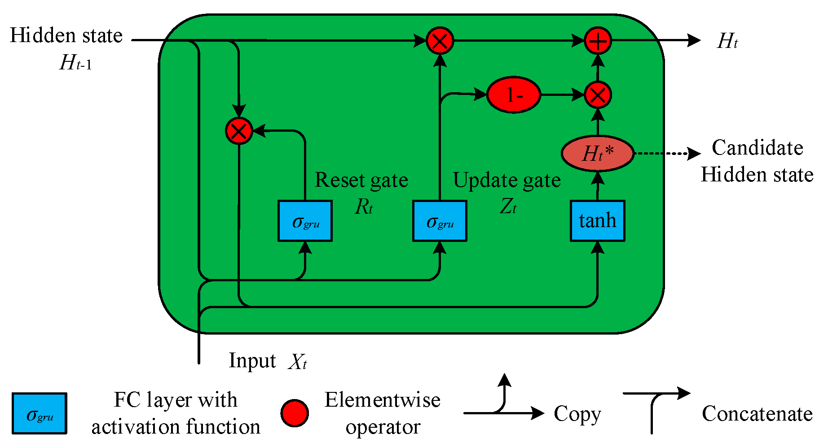
Cont…

Slide 15
Building and Training an RNN
Data Preparation: Choose a sequential dataset, split into training and testing sets.
Model Architecture: Design RNN with recurrent layers and output layer.
Recurrent Layers: Capture sequential dependencies.
Input Sequences: Format input sequences.
Output Layer: Configure for regression or classification.
Compilation: Specify loss, optimizer, and metrics.
Training: Train using the fit method with epochs and batch size.
Evaluation: Assess performance on the test dataset.
Fine-Tuning: Optionally optimize hyperparameters and architecture.

Slide 16
Overfitting and Regularization Techniques
Understanding Overfitting:
Model fits training data too closely, capturing noise.
Preventing Overfitting:
Validation Data: Monitor performance on separate validation data.
Early Stopping: Halt training when validation performance declines.
Regularization: Add complexity penalties (L1, L2).
Dropout: Randomly deactivate neurons.
Data Augmentation: Increase training data.
Reducing Model Complexity: Use simpler architecture.
These techniques mitigate overfitting and enhance model generalization

Slide 17
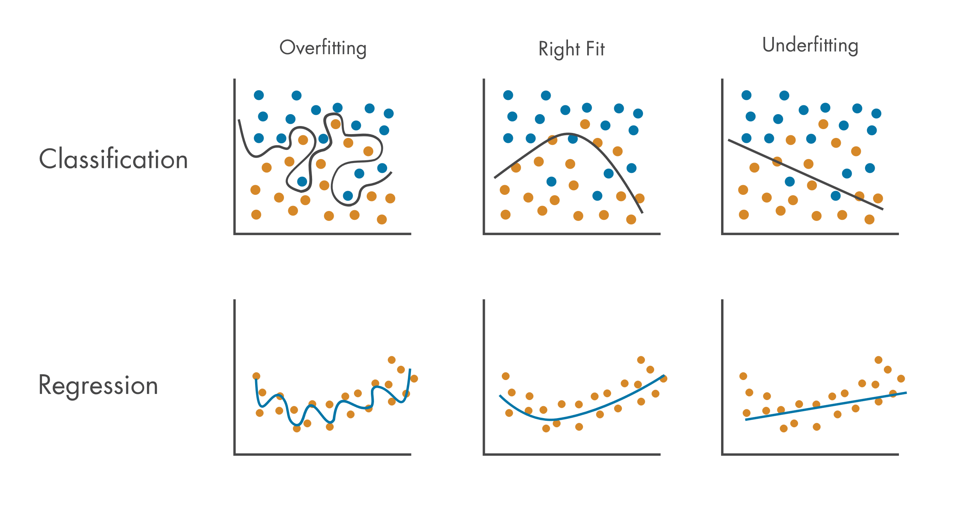
Cont…

Slide 18
Dropout and Batch Normalization
Dropout:
Randomly deactivates neurons during training.
Adds noise and redundancy to the network.
Batch Normalization:
Normalizes neuron activations with mean zero and standard deviation one.
Applied per batch of data.

Slide 19
Cont…
How Prevent Overfitting:
Dropout:
Discourages reliance on specific neurons.
Promotes the learning of more robust features.
Batch Normalization:
Reduces internal covariate shift.
Ensures network stability during training.
Prevents overfitting by avoiding over-reliance on certain scales or biases.

Slide 20
Cont…

Slide 21
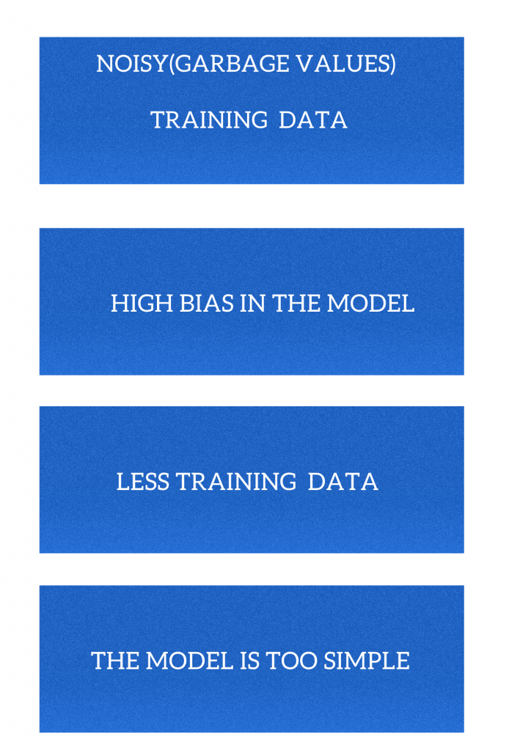
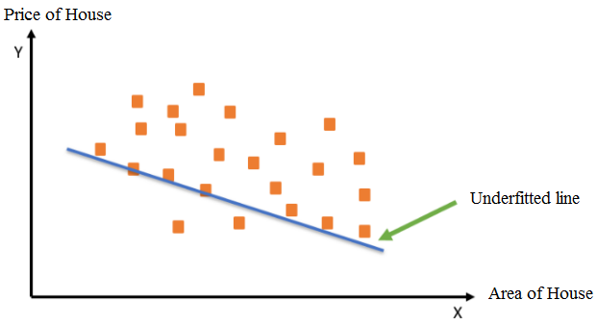
Cont…
Reasons for Underfitting
Example
Underfitting – House Prices

Slide 22

Model Evaluation and Metrics
Accuracy: Proportion of correct predictions.
Precision: Fraction of true positives among positive predictions.
Recall (Sensitivity): Fraction of true positives among actual positives.
F1 Score: Harmonic mean of precision and recall.
Specificity: Proportion of true negatives among actual negatives.
AUC-ROC: Measures model performance across different thresholds.
MAE (Mean Absolute Error): Average absolute difference for regression.
MSE (Mean Squared Error): Average squared difference for regression

Slide 23
Hyperparameter Tuning
Overview of Hyperparameters:
Control model settings and configurations.
Examples: learning rate, batch size, model complexity.
Techniques for Hyperparameter Optimization:
Grid Search: Systematic exploration of predefined values.
Random Search: Random sampling from hyperparameter space.
Bayesian Optimization: Probabilistic modeling to predict good settings.
Genetic Algorithms: Evolution-inspired optimization.
AutoML: Automated hyperparameter tuning.
Hyperband: Adaptive allocation of resources for efficient tuning.

Slide 24
Hands-on: RNN, LSTM, GRU
Dataset: New York Taxi Dataset
Make RNN, LSTM & GRU Model & Evaluate it.
Note:- Use Jupyter file for this question - RNN, LSTM & GRU - Newyork Taxi Dataset.ipynb
Notes:
Note:- Use Jupyter file for this question - RNN, LSTM & GRU - Newyork Taxi Dataset.ipynb

Slide 25
Questions ?

Slide 26
Thank You!

